Slide 1

Diagnose your Golang App anytime anywhere!
Mateusz Dymiński

Slide 2
Whoami
Mateusz Dymiński
Software Developer at Nokia
9+ exp with Java
5+ exp with Go
One of the organizer GoWroc - Golang Wroclaw Meetup
Github: github.com/mateuszdyminski
Twitter: @m_dyminski
LinkedIn: linkedin.com/in/mdyminski

Slide 3

github.com/mateuszdyminski/go-diagnose

Slide 4
Agenda
Debugging
Profiling
Tracing
Instrumentation

Slide 5

Debugging

Slide 6
Debugging
Debugging allows us to pause a Go program and examine its execution. Program state and flow can be verified with debugging.

Slide 7
Application
Simplest HTTP server with Add handler
func main() {
http.Handle("/add", http.HandlerFunc(addHandler))
log.Println("Starting HTTP server on port 8081")
http.ListenAndServe(":8081", http.DefaultServeMux)
}
Request:
http://localhost:8081/add?vals=1,2,4
Response:
results:
sum of 1,2,4 is 7.000000

Slide 8
Handler
func addHandler(w http.ResponseWriter, r *http.Request) {
valStr := r.URL.Query().Get("vals")
vals := strings.Split(valStr, ",")
acc := 0.0
for _, val := range vals {
valInt, err := strconv.Atoi(val)
if err != nil {
continue
}
acc = acc + float64(valInt)
}
w.Write([]byte("results: \n"))
fmt.Fprintf(w, "sum of %v is %f\n", valStr, acc)
}

Slide 9

Old Way of Debugging

Slide 10
Old Way of Debugging
func addHandler(w http.ResponseWriter, r *http.Request) {
valStr := r.URL.Query().Get("vals")
log.Printf("got values: %s \n", valStr)
vals := strings.Split(valStr, ",")
log.Printf("values after split: %v \n", vals)
acc := 0.0
for i, val := range vals {
valInt, err := strconv.Atoi(val)
if err != nil {
log.Printf("can't parse val: %s err: %s, skipping \n", val, err)
continue
} else {
log.Printf("val: %s parsed properly\n", val)
}
acc = acc + float64(valInt)
log.Printf("temp sum after %d of values is: %f\n", i+1, acc)
}
log.Printf("sum of %s is: %v \n", valStr, vals)
w.Write([]byte("results: \n"))
fmt.Fprintf(w, "sum of %v is %f\n", valStr, acc)
}
That’s what real HACKER does !!!!!!!!

Slide 11

We can do better

Slide 12
Go users mostly use the following debuggers
GDB: Go provides GDB support via the standard Go compiler and Gccgo. The stack management, threading, and runtime contain aspects that differ enough from the execution model GDB expects that they can confuse the debugger, even when the program is compiled with gccgo.
Delve: Delve is a debugger for the Go programming language. It has support for Go’s runtime concepts and built-in types. Delve is trying to be a fully featured reliable debugger for Go programs.

Slide 13
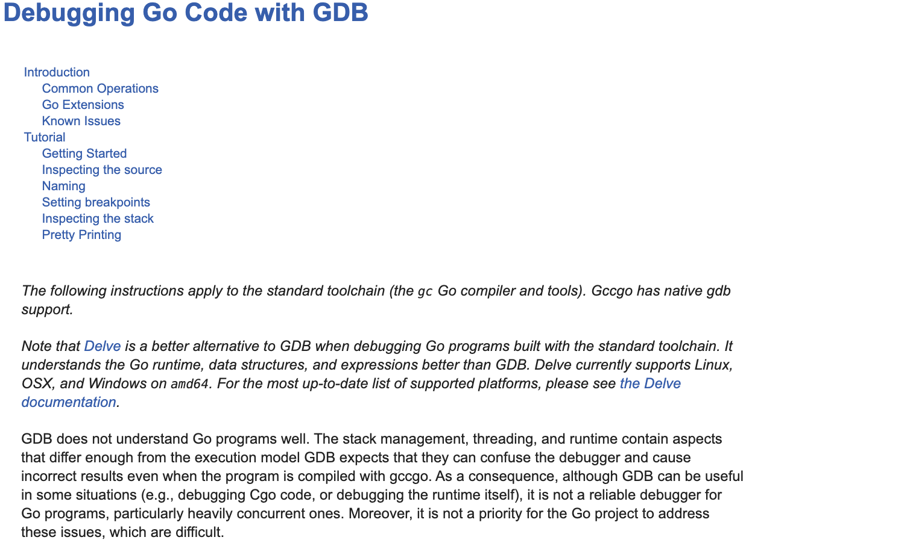
GDB

Slide 14


Slide 15
Delve debug flow
$ dlv debug github.com/mateuszdyminski/go-diagnose/debug
Invoking that command will cause Delve to:
compile the program in a way most suitable for debugging
execute previously compiled program
attach to the program and begin a debug session
Now, when the debug session has first started you are at the very beginning of the program's initialization. To get to someplace more useful you're going to want to set a breakpoint or two and continue execution to that point.

Slide 16
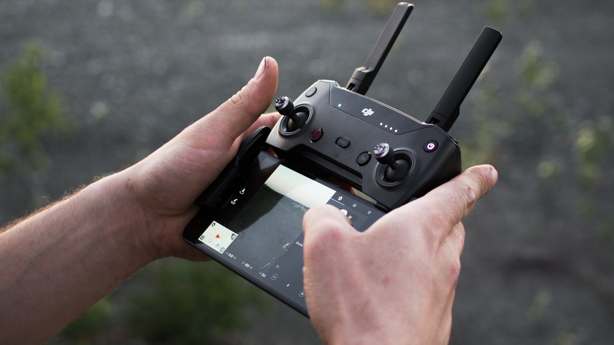
Remote Debugging

Slide 17
Remote Debugging with Delve
1. Compile our App with proper flags:
$ go build -gcflags "all=-N -l" -ldflags=-compressdwarf=false -o app-mac .
-gcflags "all=-N -l” disables inlining and most optimizations.
-ldflags=-compressdwarf=false Go 1.11 started compressing debug information to reduce binary sizes. This is natively supported by Delve, but neither LLDB nor GDB support compressed debug info on macOS. If you are using LLDB or GDB, there are two workarounds: build binaries with -ldflags=-compressdwarf=false, or use splitdwarf
2. Run application
$ ./app-mac
3. Run Delve server in headless mode:
$ dlv attach --headless --listen=:2345 --log --api-version=2 --accept-multiclient=true $(pgrep app-mac)
4. Attach IDE Debugger session to server

Slide 18

Remote Debugging App in Docker

Slide 19
Remote Debugging with Delve in Docker
Dockerfile
FROM golang:1.12.5
# Delve Configuration
RUN go get -u -v github.com/derekparker/delve/cmd/dlv
EXPOSE 40000
# App Configuration
WORKDIR /go/src/github.com/mateuszdyminski/go-diagnose
ADD main.go .
RUN go build -gcflags="all=-N -l" -o app .
EXPOSE 8081
CMD [ "dlv", "exec", "/go/src/github.com/mateuszdyminski/go-diagnose/app", "--listen=:40000", "--headless=true", "--api-version=2", "--log" ]

Slide 20
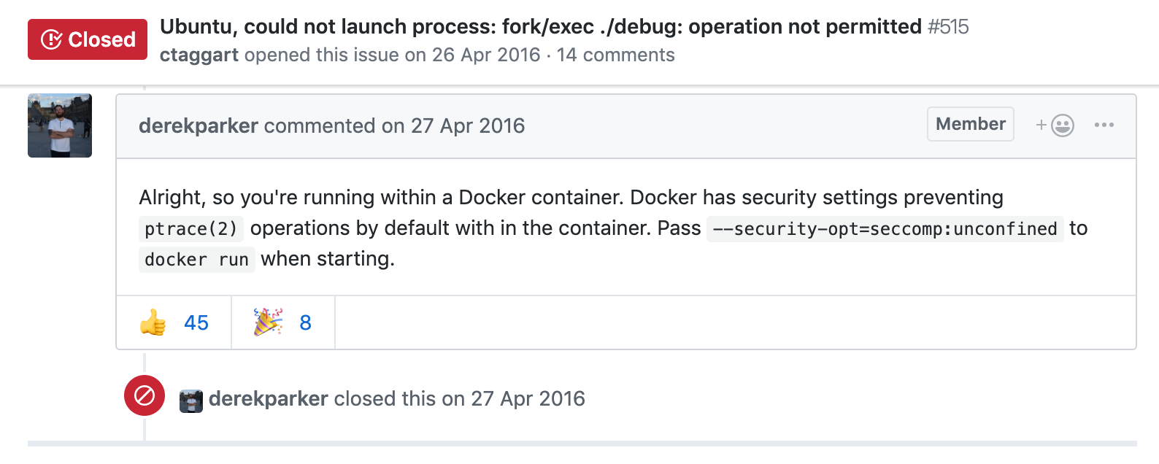
Remote Debugging with Delve in Docker
Run Docker container:
$ docker run -d -p 8081:8081 -p 40000:40000 mateuszdyminski/debug:latest
Does not work :/

Slide 21
Remote Debugging with Delve in Docker
Run Docker container:
$ docker run -d -p 8081:8081 -p 40000:40000 --security-opt=seccomp:unconfined mateuszdyminski/debug:latest

Slide 22

Postmortem Debugging

Slide 23
Postmortem Debugging
Sometimes our application dies and we would like to analyze what happend.
It is possible to obtain core files from Go programs and use delve or gdb to debug.
A core dump file is a file that contains the memory dump of a running process and its process status.

Slide 24
Core File – How to
Crash dumps, these are basically core dumps written to disk when a program is crashing. Go doesn’t enable crash dumps by default but gives you this option on Ctrl+backslash when GOTRACEBACK env variable is set to “crash”.
$ GOTRACEBACK=crash ./app-mac
(Ctrl+\)
Another option is to retrieve a core dump from a running process without having to kill a process. With gcore, it is possible to get the core files without crashing. Let’s start the server again:
$ ./app-mac &
$ gcore 3214 # 3214 is the PID of app-mac

Slide 25
Postmortem Debugging
We have a dump without crashing the process. The next step is to load the core file to delve and start analyzing.
$ dlv core ./app-mac /cores/app-mac-99182-20190611T210621Z
This is no different than the typical delve interactive. You can backtrace, list, see variables, and more. Some features will be disabled given a core dump is a snapshot and not a currently running proces.

Slide 26
Debugging - takeaways
Debugging local Application is very easy
Attaching to production Application(non-Docker) is pretty straighforward, but:
it stops the execution of the entire App when we start dlv server
we need to have proper binaries – compiled without the optimizations
we need to restart dlv server everytime we would like to attach debugger
Attaching to production Application in container is problematic:
we need to create dedicated container image to make debugging possible
we need to run container with unsecure way
application will stop when we disconnect from dlv
Even if our Application dies is not too late for debugger

Slide 27

Profiling

Slide 28
Profiling
Profiling tools analyze the complexity and costs of a Go program such as its memory usage and frequently called functions to identify the expensive sections of a Go program.

Slide 29
pprof
pprof is a tool for visualization and analysis of profiling data.
Go has powerful profiling built in to the runtime
CPU profiles (stack sampling)
Heap profiles using allocation profiling
and more (block profiles, threadcreate, goroutine, mutex, etc)
Accessible through pprof and runtime packages.

Slide 30

Tracing

Slide 31

Instrumenting

Slide 32

Q&A

Slide 33
REST
func (r *UserRest) Users(w http.ResponseWriter, req *http.Request) {
rows, err := r.db.Query("SELECT * FROM users")
if err != nil {
WriteErr(w, err, http.StatusInternalServerError)
return
}
users := make([]User, 0, 0)
for rows.Next() {
var uid int
var firstName, secondName string
var birthDate time.Time
err = rows.Scan(&uid, &firstName, &secondName, &birthDate)
if err != nil {
WriteErr(w, err, http.StatusInternalServerError)
return
} users = append(users, User{ID: uid, FirstName: firstName, SecondName: secondName, BirthDate: birthDate})
}
if rows.Err() != nil {
WriteErr(w, rows.Err(), http.StatusInternalServerError)
return
}
WriteJSON(w, users)
}

Slide 34
Demo Users Service
Run
$ go run main.go --db-pass=password --db-host=192.168.99.101:31125
http://localhost:8080/api/users
apiVersion: v1
kind: Service
metadata:
name: users-go-api
spec:
type: NodePort
ports:
- port: 8080
nodePort: 31001
selector:
app: users-go-api

